Slide 1
Packet classification Hierarchical based algorithm
Algorithm implementation in Python
Algorithm performance parameters
Professor(s): Achille Pattavina and Guido Maier
Assistant: Sebastian Troia
Mohammad Ala Amjadi
Person code: 10479915
Master of telecommunication engineering
Politecnico di Milano – September 2020

Slide 2
Introduction
1
To meet various QoS requirements, routers need to implement the following features
Admission control
Resource reservation
Per-flow queueing
Fair scheduling
They need to be able to distinguish and classify the incoming traffic into different flows (flow-aware routers) which is the principle of SDN and OpenFlow
Flows are specified by rules
Each rule consist of operations comparing packet fields with certain values
A set of rules is called a classifier
Based on the criteria to be applied to classify packets with respect to a given network application
2
3
4

Slide 3
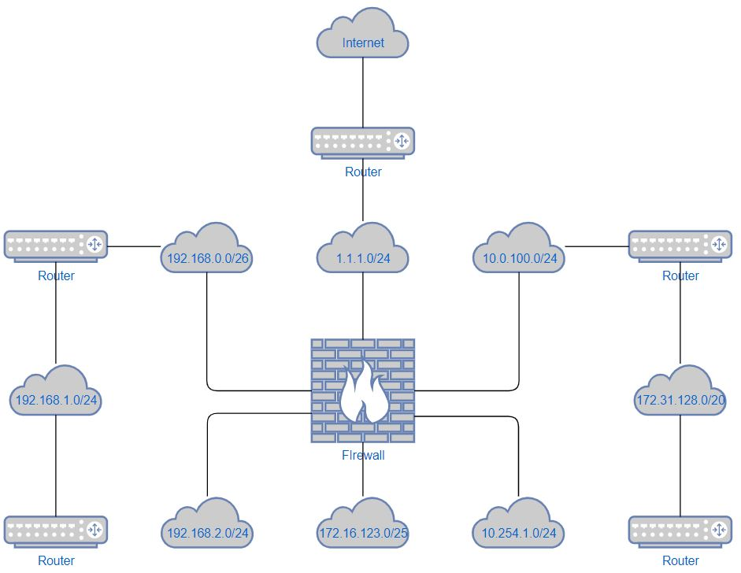
Network Diagram in general

Slide 4
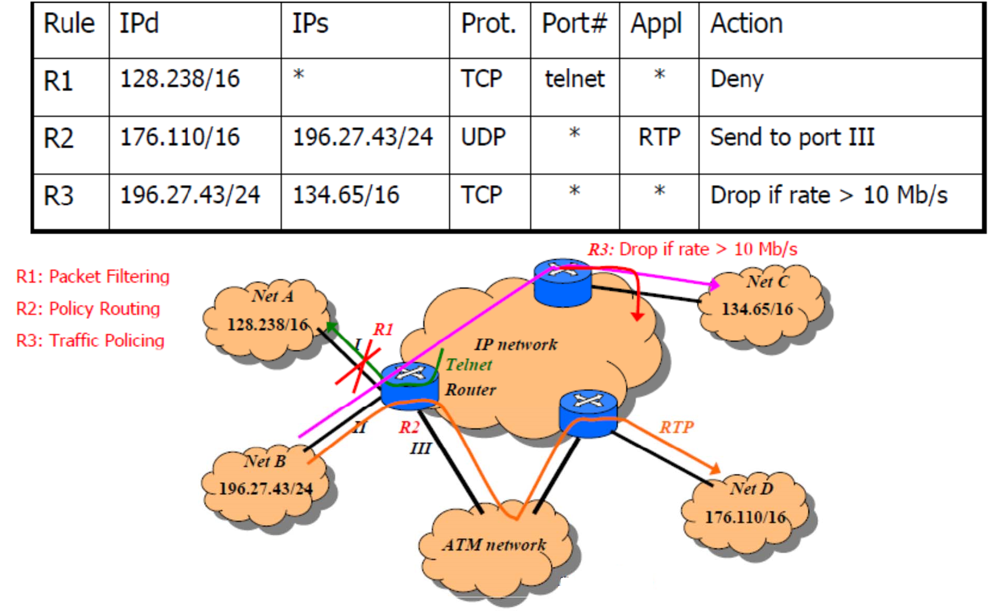
A packet classifier example

Slide 5
Classifier definition
A classifier C consists of N rules, Rj, 1 ≤ j ≤ N, where Rj is composed of three entities:
A regular expression Rj[i], 1 ≤ i ≤ d, on each of the d header fields of a packet.
A number, Pri(Rj), indicating the priority of the rule in the classifier.
An action, referred to as Action(Rj).
An incoming packet P with the header considered as a d-tuple (P1, P2, . . . , Pd) is said to match Rj , if and only if, Pi matches Rj[i], where 1 ≤ i ≤ d.
Given an incoming packet P and thus the d-tuple, the d-dimensional packet classification problem is to find the rule Rm with the highest priority among all the rules Rj matching the d-tuple
An IPv4 packet header, consists of:
Source IP 32bits
Destination IP 32bits
Protocol 8bits
Source port 16bits
Destination port 16bits
The matching rule in the classifier with the highest
priority is chosen and its corresponding action is
applied to the packet

Slide 6
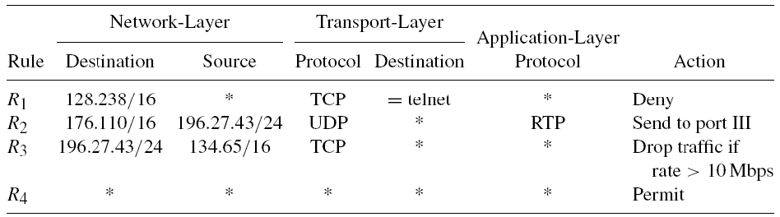
Classifier table example
Each rule has five regular expressions on five packet-header fields from network layer to application layer
Each expression could be:
Simple prefix/length specification => Same definition as in P lookups
Operator/number specification => could be more general, such as equal 23, range 256-1023, and greater than 1023
A wildcard can be inserted to match any value.
Note R4 ‘all-wildcards’ specification => matches with any incoming packet
The priorities of rules take effect when a packet matches both R4 and other rules

Slide 7

Program structure
Hierarchical_algorithm.py main algorithm functions
Network_utils.py customized general functions and rules
main.py program to run the algorithm
rule_list.txt classification rule list
random_packets.txt randomly generated incoming packets list
incoming_packets.txt customized incoming packets list

Slide 8
Flow

Slide 10
Performance Evaluation – Time
Search Speed (Classification time):
The total classification increases linearly with the incoming packets
Storage requirement (memory):
evaluation was not successful since the outcome measurements were inaccurate.
Scalability:
Size: classified 1 Million entries in 14425 ms
Header fields: this program doesn’t accept dynamic dimension of classifiers.
Update time:
This program doesn’t consider updates of rules in its algorithm.
Flexibility in specification:
This program accepts NetID and ranges for port numbers.
Using different NetID increased the classification time. Using port ranges instead
of numbers did not increased the classification time significantly.

Slide 11
End
Questions?

